Slide 1


THE BUREAU OF TRANSPORT STATISTICS

Slide 2
EXPLORATORY DATA ANALYSIS
BTS

Slide 3
CONTENTS
INTRODUCTION
Problem Statement
Objective
DATA UNDERSTANDING
DATA EXPLORATION
Univariate Analysis
Bi-variate Analysis
Multi-variate Analysis
INFERENCES

Slide 4

PROBLEM STATEMENT
CBP (Customs and Border Protection) does not collect comparable data on outbound crossings. Users seeking data on outbound counts want to review data from individual bridge operators, border state governments, or the Mexican and Canadian governments about the Inbound Data Analysis to uncover underlying patterns and structures from the data.
OBJECTIVE
Exploratory data analysis
Summary level insights from the dataset
Uncover underlying patterns and structures from the data
Relate the available data to the problem statement.

Slide 5
UNDERSTANDING OF THE DATA
Dataset is about: The Bureau of Transportation Statistics (BTS) Border Crossing Data provide summary statistics for inbound crossings at the U.S.-Canada and the U.S.-Mexico border at the port level. Data are available for trucks, trains, containers, buses, personal vehicles, passengers, and pedestrians.
Upon exploring the dataset had 7 explanatory variables in it. To understand the variables in the dataset, below is the data understanding of the variables and it’s description:
Port Name : Name of CBP Port of Entry
State : State Name
Port Code : CBP Port Code
Border : US-Canada Border or US-Mexico Border
Date : DDMMYYYY - Monthly Data
Measure : Conveyances, containers, passengers, pedestrians
Values : Count of people
Based on the above understanding of the variables we imported the datasets into our working environment (Google Colab)
The datasets provided contained the following:
Shape of data : (106102, 7)
Categorial variables: Port Name, State, Border, Measures
Numerical variables: Port Code, Value
Datetime format: Date

Slide 6
UNIVARIATE ANALYSIS
Dataset consists of data of two states border
US-Canada Border
US-Mexico Border
Total 15 unique States in the dataset.
Total 12 unique Measures in the dataset.
No NaN value was observed in the dataset.
Total of 29,708 zero values in ‘Value’
New shape of data after dropping zero’s: (76394,7)
Same Port name (Eastport) is in two different state with different port code

Slide 7
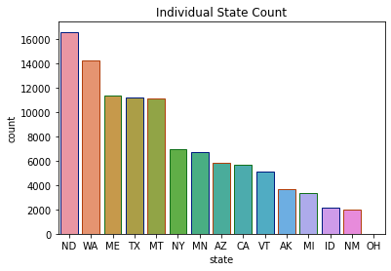
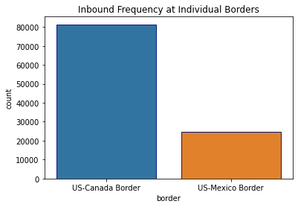
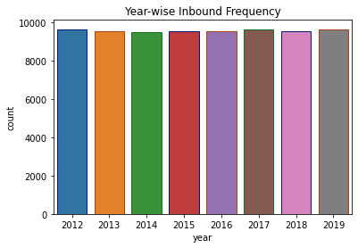

UNIVARIATE
DATA-ANALYSIS
The above plot represent the frequency of border crossing in each state. The top 5 states are ND, WA, ME, TX and MT.
Out of the two international USA borders, USA-Canada Border has the highest number of inbound frequency.
Yearly inbound frequency remains the same from 2012-2019.

Slide 8
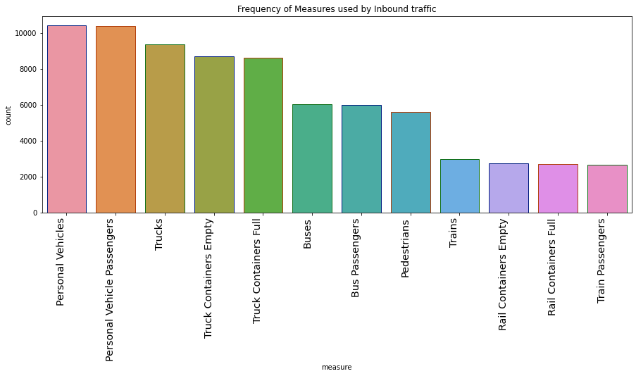
UNIVARIATE
DATA-ANALYSIS
The plot shows the count of each mode of transport used to cross US_Mexico and US_Canada borders.
Passengers has used Personal Vehicles the most to cross border..
The second most used measure is Trucks followed by bus and pedestrians. And the least used mode is Train.

Slide 9
BI-VARIATE ANALYSIS

Slide 10
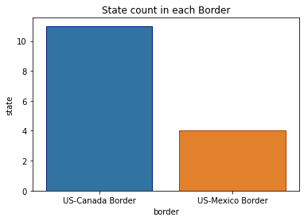
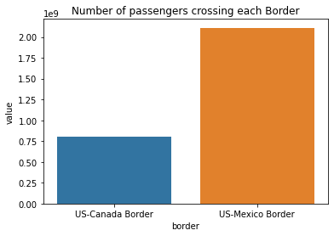
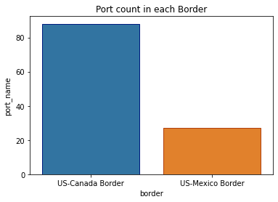
BI-VARIATE
DATA-ANALYSIS
There are total 15 states in USA Border. 11 states falls between US-Canada Border and 4 states between US-Mexico Border.
Out of the two international USA borders, USA-Mexico Border has the highest number of inbound frequency.
The above plot is showing the number of ports each border is having. US-Canada border has the highest number of ports.

Slide 11
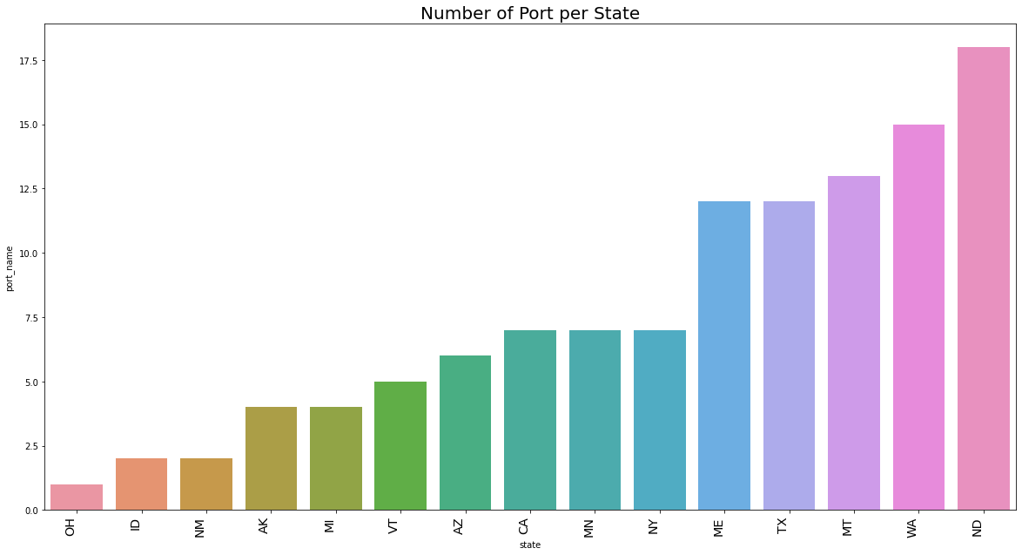
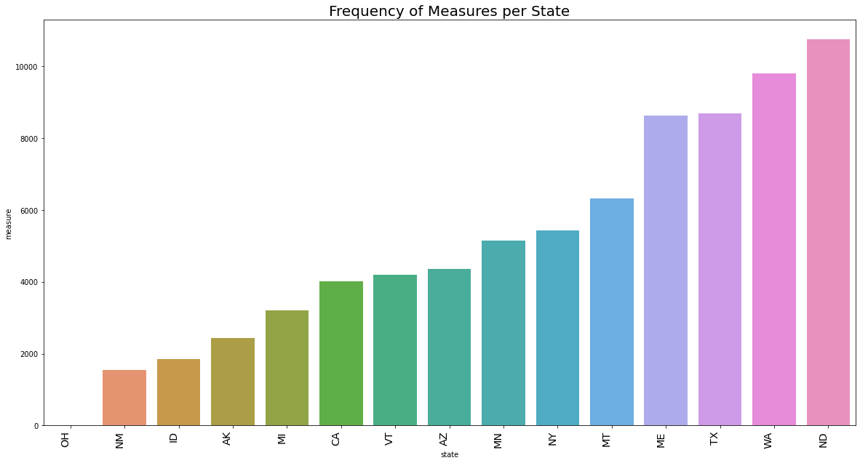
BI-VARIATE
DATA-ANALYSIS
The following plot shows the number of ports each state is having, including both the borders. The state with code ND, WA, MT, TX and ME are the 5 states having maximum number of ports.
From the observation of both the plots we can infer that the states having the highest number of ports are also having the highest frequency of inbound measures.

Slide 12
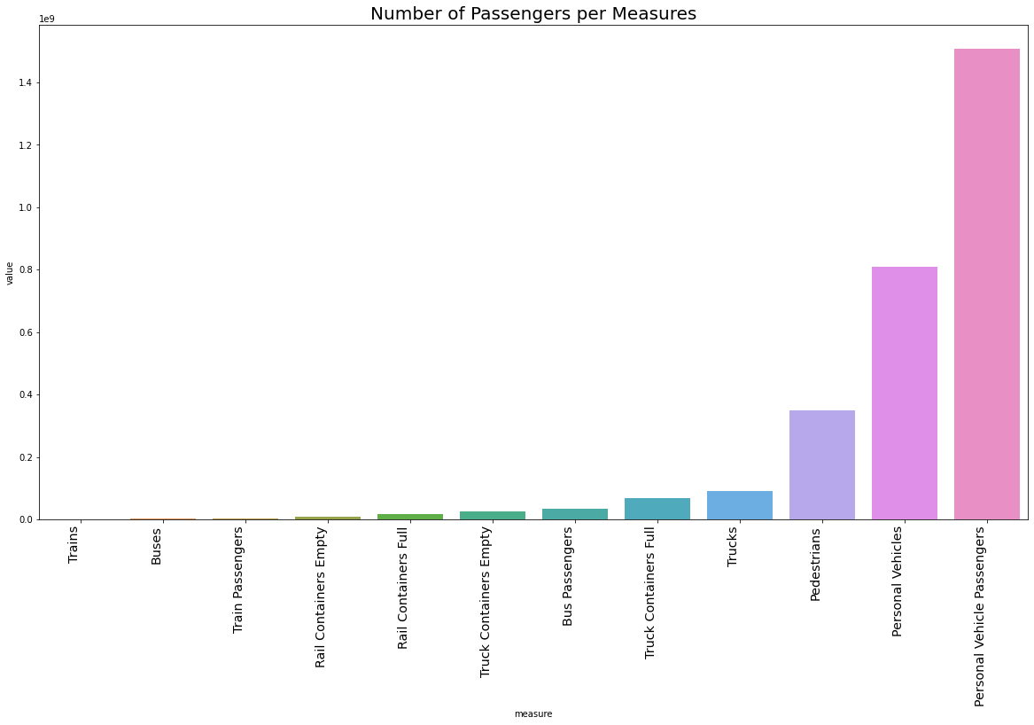
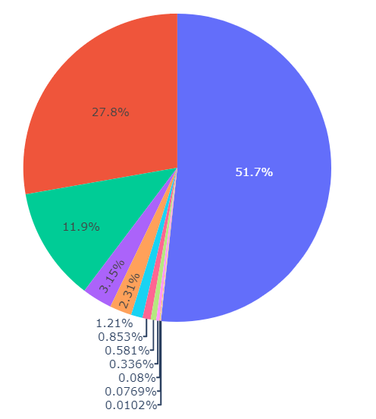
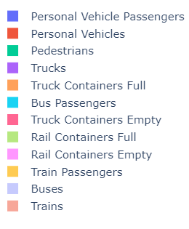
BI-VARIATE
DATA-ANALYSIS
Both the plot and the pie chart gives us the number of passengers each measure is transporting through the border for the given period of 8 years. We can infer that Personal vehicles are transporting almost 80% of the passengers, followed by pedestrian passengers of about 12%.

Slide 13
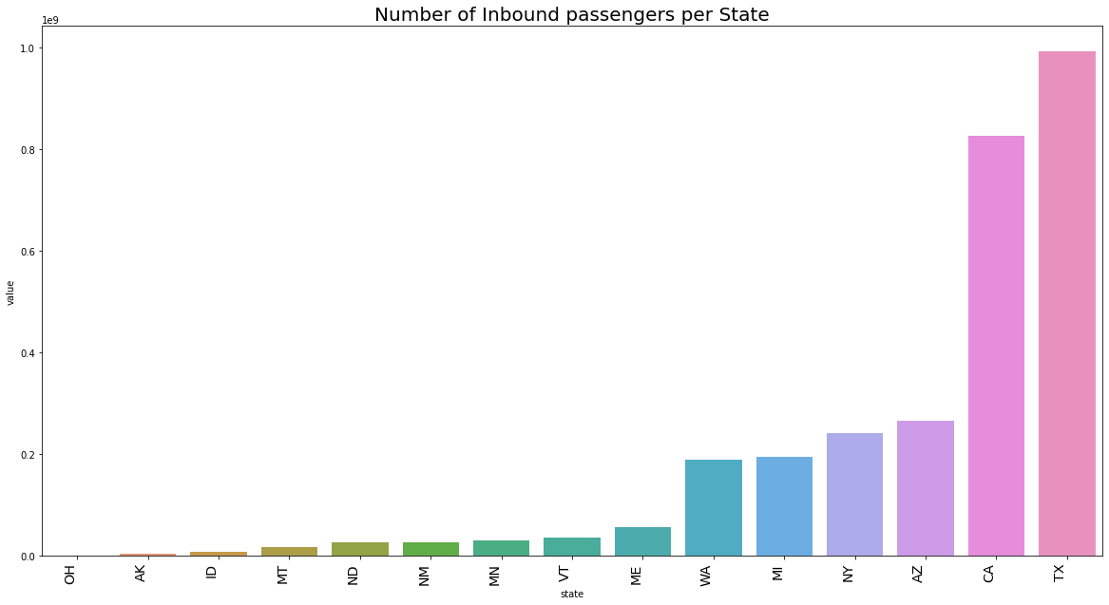
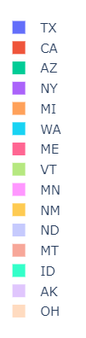
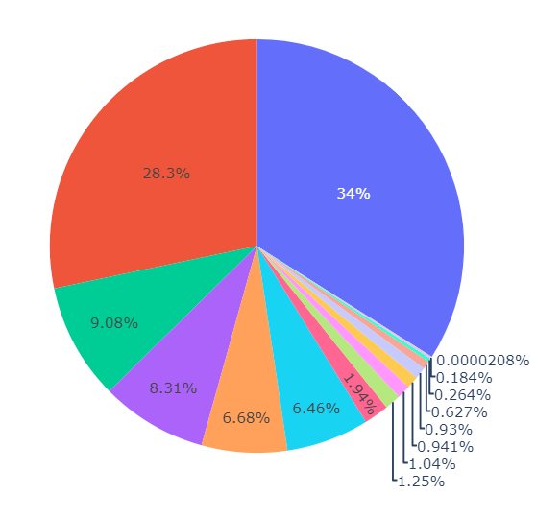
BI-VARIATE
DATA-ANALYSIS
The states with maximum number of inbound passengers ordered in ascending manner, are shown below. The top 5 states are TX with 34% traffic, CA-28%, AZ-9%, NY-8% and MI with 6.68% traffic. Although ND, WA, MT was the top 3 state associated with the number of ports, still has very less amount of inbound traffic.

Slide 14
MULTI-VARIATE ANALYSIS

Slide 15
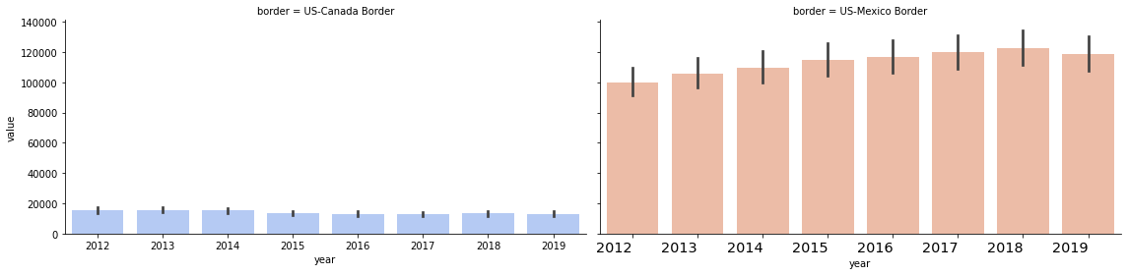
MULTI-VARIATE
DATA-ANALYSIS
Border wise comparison between passengers crossing border each year. The plot clearly shows that the traffic are lot higher in US-Mexico border compared to US-Canada border. In spite of having 11 states and 88 ports in US-Canada border compared to 4 states and 27 ports in US-Mexico border, US-Mexico border have very high traffic each year. And the years 2017, 2018 and 2019 encountered the highest number of inbound traffics.

Slide 16
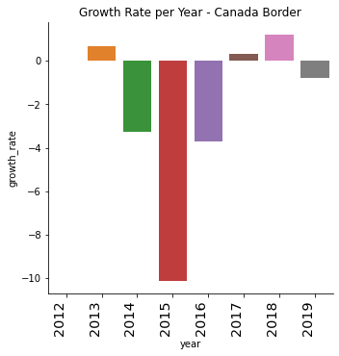
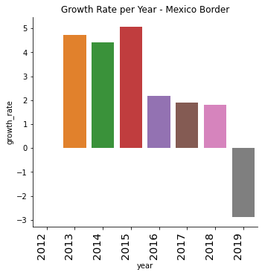
MULTI-VARIATE
DATA-ANALYSIS
The following two plots are showing the growth rate of the number of passengers crossing the borders per year. In US-Canada border, 2015 had seen highest fall in growth rate moreover the year 2018 has encountered with highest growth rate. In US-Mexico border 2015 had the highest growth rate. And the growth rate gradually decreased 2016 onwards with 2019 having the highest fall in growth rate.

Slide 17
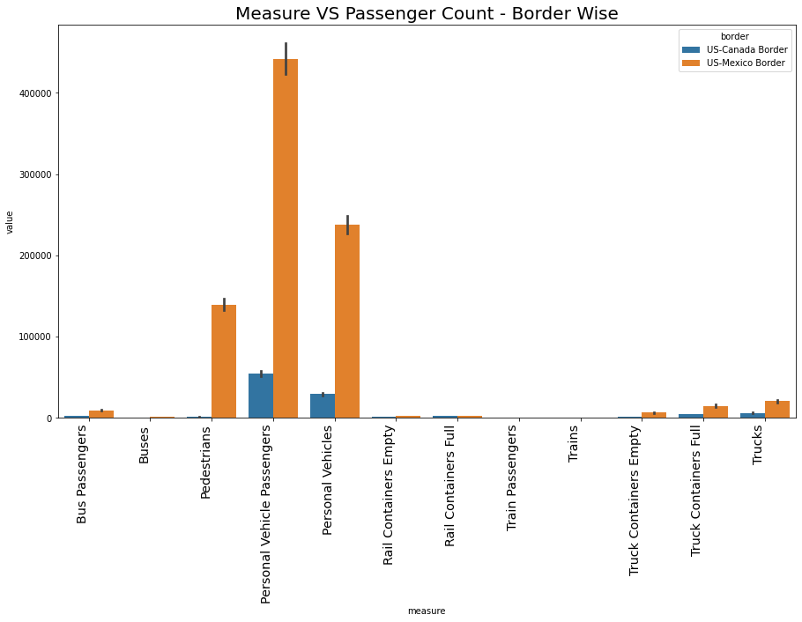
MULTI-VARIATE
DATA-ANALYSIS
The following plot shows the numbers of inbound passengers with different modes of transports across the different borders.
According to the plot, the personal vehicle have most inbound passengers for both the borders.
Secondly, it is observed that the heavy vehicle category including Train, Bus and Truck are having very less inbound passengers compared to light weight vehicles and pedestrians.

Slide 18
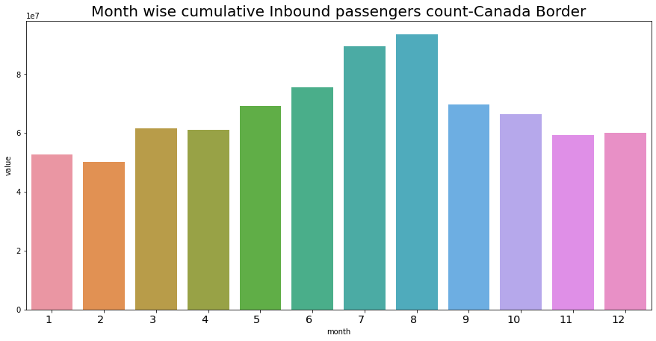
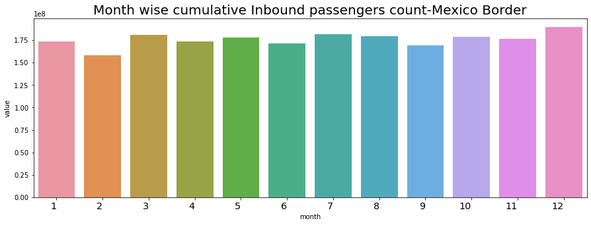
MULTI-VARIATE
DATA-ANALYSIS
The following plot shows the month wise inbound passengers count throughout all the years from 2012 to 2019 across the US-Canada border. July and August seeing the highest rise in the passengers crossing the borders.
On the contrary, the US-Mexico border has seen a constant distribution of passengers count for all the months over the same period (2012-2019).

Slide 19
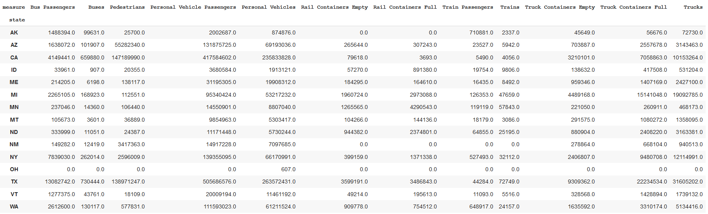
MULTI-VARIATE
DATA-ANALYSIS
From the below pivot table we can compare the number of passengers using different measures in each state.
In the state OH(Ohio) the trade is null and only mode of commute is personal vehicle.
In all states personal vehicle commute is the highest.

Slide 20
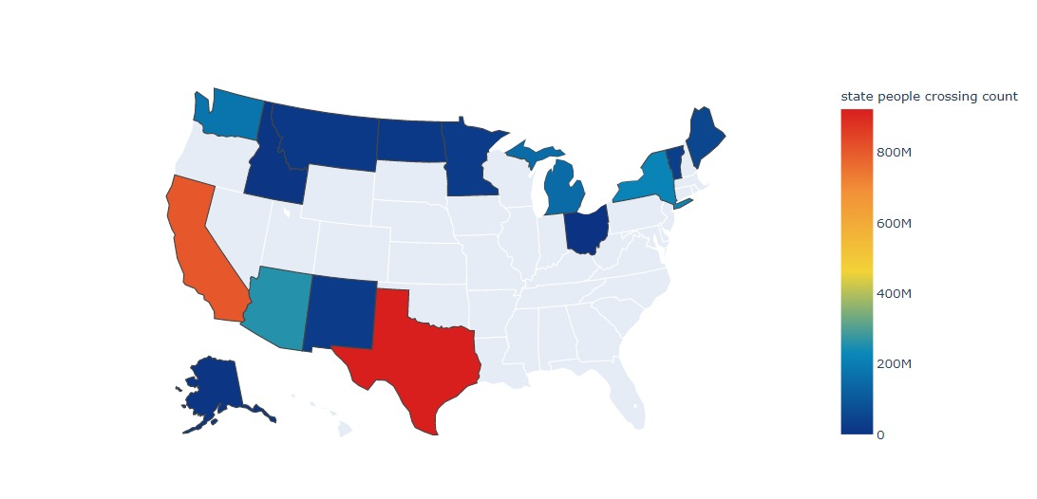
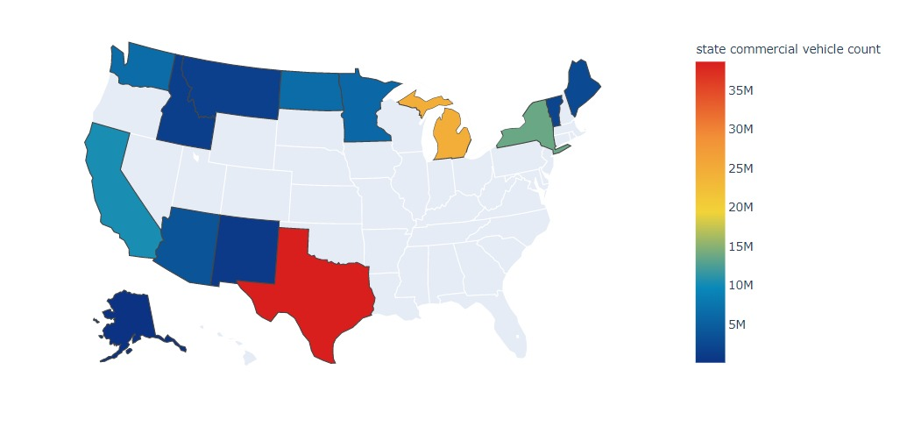
MULTI-VARIATE
DATA-ANALYSIS
Graphical representation of the pivot table

Slide 21
TRADE ANALYSIS

Slide 22
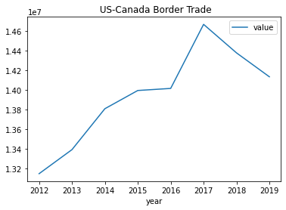
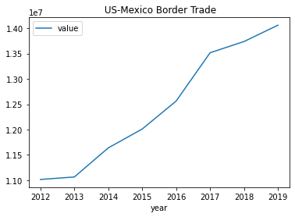
TRADE ANALYSIS
For USA-Canada border we can observe a constant growth in land bound trade from 2012-2017, since 2017 there is steep decline in amount of trade
For USA-Mexico border we can observe a constant growth in land bound trade.

Slide 23
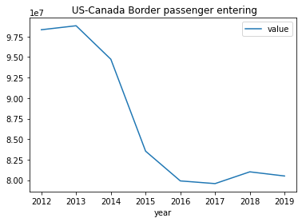
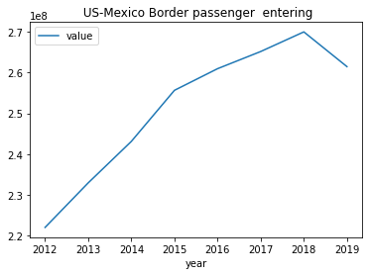
TRADE ANALYSIS
In USA-Canada Border we can see a sharp decline in passenger entry.
One of the possible explanation can be people are taking flights.
In USA-Mexico Border we can see there is a constant growth in passenger entry
This can be due to high immigration from Mexico to USA

Slide 24
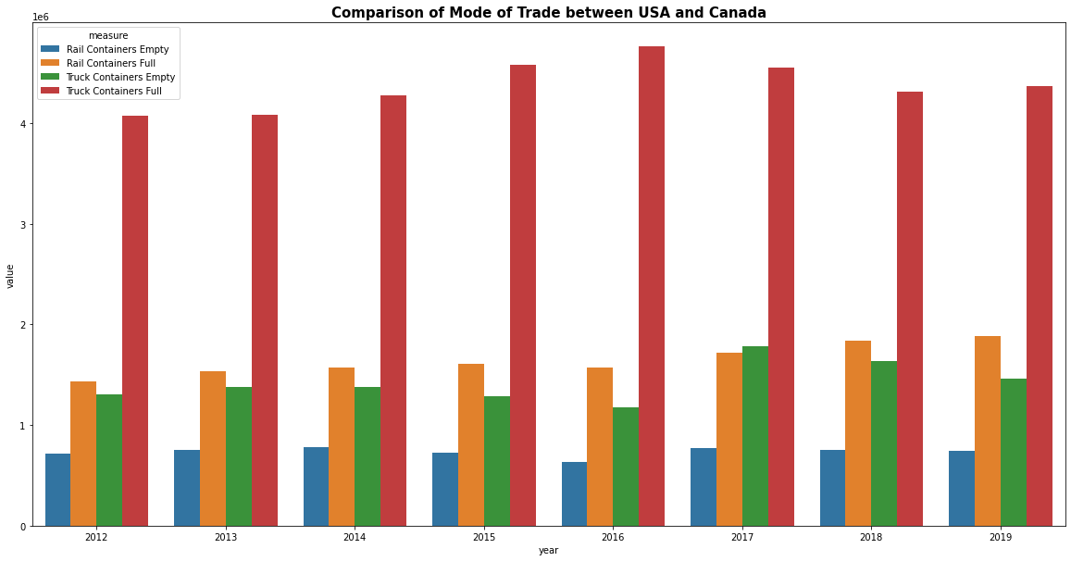
TRADE ANALYSIS
In USA-Canada border we observe
Full containers are more than empty containers
This could possibly indicate a land based trade deficit with Canada

Slide 25
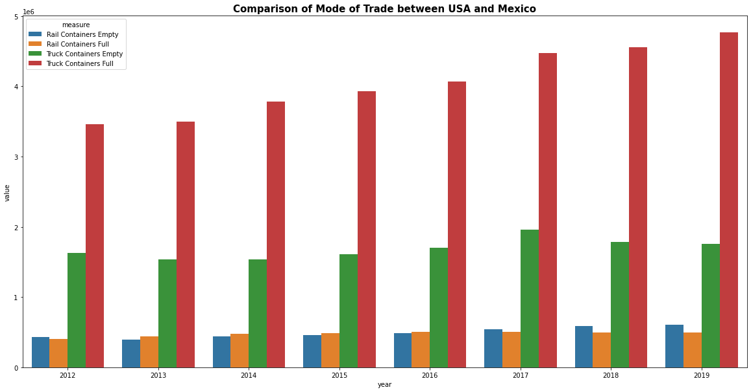
TRADE ANALYSIS
In USA-Mexico border we observe similar pattern as USA-Canada data

Slide 26

CONCLUSION
As most of the attributes in the dataset are categorical, so statistical inferences were not possible.
Decrease in the frequency of inbound passenger from year 2012 to 2019 from both the borders.
The light vehicle category including (Personal vehicle) has most number of inbound passengers across the borders.
There are more number of states and port in US-Canada border when compared with US-Mexico Border however the number of inbound passengers is much more in US-Mexico Border.
This might be due to the fact that Canada is having less population when compared with Mexico.
We can observe highest inbound traffic in the following two states TX (Texas) and CA (California), might be for the reason that both are the most highly populated state in USA.
From the month-wise breakup of the traffic for both the borders in case of US-Canada Border, there has been a steep rise from the month of May till July. The reason might be that Canada lies in Northern hemisphere so it experiences summer season in those months. Hence we might relate more number of inbound passengers with the season since it is the most favorable time to commute by road.
Whereas Mexico lies near the equator, experiences hot and humid weather.
In case of US-Mexico border despite the imposition of restrictions on Trade rule by the new US administration after 2016 we cannot observe any fall in trade count
Colab file link

Slide 27


MEET THE TEAM

Slide 28
THANK YOU!

